Slide 1
PROGRAMMING FOR DATA SCIENCE
WILL AI REPLACE
YOUR JOB?
A machine-learning analysis of occupational AI risk
Exploratory analysis | Statistical inference & ML
Karepalli Varun Reddy (24BDS1126) • Madheshwaran P (24BDS1159)
VIT CHENNAI

Slide 2
PART 01
DA 1 — EXPLORATORY DATA ANALYSIS
Understanding the dataset before statistical testing and machine learning

Slide 3
Problem statement and objectives
AI is changing tasks and workflows across industries, raising questions about job security and reskilling.
Build a machine-learning model to estimate the automation-risk score recorded for a job posting.
Explore relationships between the target and job, salary, industry, company and AI-related attributes.
Prepare the data, investigate patterns and communicate findings relevant to career planning and workforce development.
DA 1 | Programming for Data Science
4

Slide 4
Dataset identification and structure
5,000
22
2010–2025
Target
job-posting records
variables / columns
dataset time span
automation_risk_score
Dataset: Global AI Job Market Dataset (2010–2025), by Terence Katua on Kaggle.
Each record represents an individual job posting.
Variables combine job/market details with AI skills, AI intensity, salary and automation-risk information.
The report classifies features as 6 numerical, 14 categorical and 2 Boolean.
DA 1 | Programming for Data Science
5

Slide 5
Literature review — the research gap
Prior studies motivate the question, but the report identifies a gap in occupation-level prediction.
Wong (2024)
Shen & Zhang (2024)
Examined AI’s uneven impact across secondary-student career paths. Limitation descriptive analysis only; no predictive model.
Panel data from China (2006–2020); AI raised productivity via “virtual agglomeration.” Limitation: provincial-level rather than occupation-level ML prediction.
Peng & Bhaskar (2023)
Tiwari (2023)
Interdisciplinary review of factors that make tasks automatable. Limitation: no system applied to real job-market records.
Discussed automation, inequality, policy and reskilling. Limitation: no statistical model for automation likelihood.
Acemoglu et al. (2022)
Used US vacancy data; AI reshapes tasks more than it eliminates jobs. Limitation: focus on hiring trends, not per-occupation risk prediction.
DA 1 | Programming for Data Science
6

Slide 6
Dataset dictionary — what the 22 variables represent
Identifiers & time
Location & employer
AI exposure & skills
job_id • posting_year
Used to identify a posting and locate it in the 2010–2025 timeline.
country • region • city
company_name • company_size
industry • job_title • seniority_level
ai_mentioned • ai_keywords
ai_intensity_score • core_skills
ai_skills • job_description_embedding_cluster
Pay & change
Risk & response
Industry context
salary_usd
salary_change_vs_prev_year_percent
Annual salary and percentage change versus the previous year.
automation_risk_score (target)
reskilling_required
ai_job_displacement_risk
industry_ai_adoption_stage
Indicates the reported stage of AI adoption within an industry.
Report summary: 6 numerical features, 14 categorical features and 2 Boolean features. These counts describe the report’s original dataset summary.
DA 1 | Programming for Data Science
7

Slide 7


Data preprocessing and validation
Imported the CSV into RStudio and checked dimensions, structure and summary statistics.
Checked missing values; the report identifies missing text entries in ai_keywords and ai_skills.
Replaced missing text values with “Not Specified” and checked missingness again.
Checked duplicate rows; the report records 0 duplicates.
Exported the cleaned data to CSV for downstream analysis.
DA 1 | Programming for Data Science
8

Slide 8
Preprocessing — exact workflow reported
The original dataset was preserved while a cleaned CSV was exported for subsequent analysis.
1 Import & inspect
2 Missing values
3 Duplicates
4 Export cleaned data
Imported the CSV into RStudio.
Checked dimensions, structure, data types and summary statistics.
Checked missingness with colSums(is.na(...)).
Replaced NA values in ai_keywords and ai_skills with “Not Specified”.
Rechecked missing values.
Checked duplicate records using sum(duplicated(...)).
The report found zero duplicate records.
Used readr::write_csv() to save the cleaned data as:
cleaned_ai_impact_jobs_2010_2025.csv
DA 1 | Programming for Data Science
9

Slide 9
Key takeaways
The dataset contains 5,000 postings and 22 variables; automation_risk_score is the target.
Cleaning addressed missing text fields and confirmed no duplicate rows in the report.
EDA compares salary, industry, country, adoption stage and experience-level patterns.
The scatterplot motivates formal statistical analysis
EDA describes the sample; it does not by itself establish statistical significance or causality.
DA 1 | Programming for Data Science
16

Slide 10
PART 02
DATABASE RETRIEVAL, FEATURE ENGINEERING & 10 REGRESSION MODELS
SQLite Relational Infrastructure, Statistical Audit, 54 Predictor Features & 10 Machine Learning Regressors
Programming for Data Science | VIT Chennai | Slide 16
Notes:
In Part 2, we directly address faculty feedback by incorporating ALL 20 input variables, retrieving data from SQLite, and evaluating 10 machine learning regression models on identical held-out test data.

Slide 11
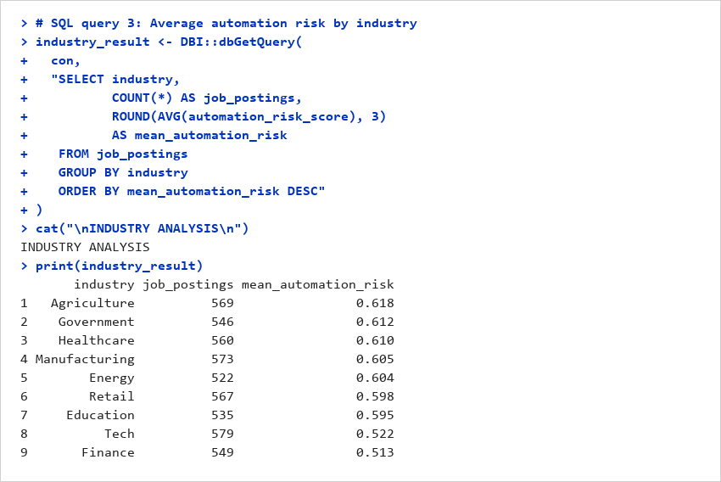
SQL-based industry analysis
HIGHEST SHOWN
• Agriculture: mean risk 0.618 (569 job postings).
• Government: mean risk 0.612 (546 postings).
• Healthcare: mean risk 0.610 (560 postings).
LOWEST SHOWN
• Finance: mean risk 0.513 (549 job postings).
• Tech: mean risk 0.522 (579 job postings).
• Education: mean risk 0.595 (535 postings).
WHAT SQL DID
• Grouped all 5,000 job postings by industry in SQLite database ai_jobs.db.
• Calculated record counts and average automation risk score per industry.
• Validated database-level data extraction prior to downstream model training.
R console output — SQLite industry aggregation
DA 2 | Programming for Data Science
18
Notes:
This slide restores the exact SQL industry analysis from the original presentation, using DBI::dbGetQuery in SQLite to aggregate all 5,000 records across 9 industry sectors.

Slide 12
Step 1 — Dataset Audit & All 22 Columns Verified
5,000
job-posting records
22
raw columns verified
0
missing values in dataset
20
input predictor columns
DATASET ARCHITECTURE & INTEGRITY
• Dataset: cleaned_ai_impact_jobs_2010_2025.csv (preserved without alteration).
• Observations: Exactly 5,000 global job postings spanning 2010 to 2025.
• Completeness: Zero missing values across all 22 columns; zero duplicate rows.
• Identifiers: job_id (unique record key; excluded from predictive modeling).
• Target Variable: automation_risk_score (continuous numeric, range 0.10 to 0.90, mean = 0.584, SD = 0.250).
• Predictor Columns: 20 input columns covering salary, seniority, company size, posting year, industry, core skills, AI skills, and location.
ADDRESSING THE 'SINGLE-VARIABLE' CRITIQUE
• Previous DA1/Old Run Limitation: The earlier baseline model relied overwhelmingly on ai_intensity_score, neglecting the remaining 19 attributes.
• Faculty Feedback: Instructed that new models must incorporate ALL input variables.
• Resolution in DA2/DA3: All 20 predictive columns are engineered and fed into the model matrix.
• Feature Expansion: Categorical and text fields are parsed and dummy-encoded, yielding 54 engineered features and 153 total model predictors.
• Validation: Held-out test evaluations demonstrate significant error reductions and R² improvements across all 10 algorithms.
DA 2 | Programming for Data Science
19

Slide 13
Step 2 — Feature Engineering Across All 20 Variables
TEXT & KEYWORD QUANTIFICATION
• Parsed ai_keywords and core_skills text strings.
• Engineered keyword counts: ai_keywords_count, core_skills_count, ai_skills_count.
• Extracted 8 binary domain flags: NLP, deep learning, computer vision, LLMs, MLOps, SQL, Python, statistics.
• Included missingness indicator flags for unlisted skills.
DOMAIN & INTERACTION FEATURES
• Log Salary: log(salary_usd) to normalize wage distribution.
• Industry Relative Wage: salary_rank_industry percentile.
• Temporal Trend: years_since_2010 = posting_year - 2010.
• Wage Trajectory: salary_increased binary indicator.
• Numeric Mappings: seniority_numeric (1-5), ai_mentioned_num, reskilling_num.
CATEGORICAL ONE-HOT ENCODINGS
• Dummy-coded all categorical fields: industry (9), company_size (4), seniority_level (5), country (40), region (8), city (12).
• Incorporated semantic embedding clusters: job_description_embedding_cluster.
• Incorporated sectoral adoption stage: industry_ai_adoption_stage.
• Total feature matrix expands from 20 raw inputs to 153 encoded predictors.
EMPIRICAL VERIFICATION
• Verified no data leakage: transformations computed strictly on training split.
• Near-zero variance check confirmed all retained predictors carry informational variance.
• Correlation audit identified multi-collinear groupings handled via regularized regression.
• Preserved complete feature space across all 10 model architectures.
DA 2 | Programming for Data Science
20
Notes:
Feature engineering details: converting 20 raw variables into 54 engineered features and 153 one-hot columns.

Slide 14
Predictor Fields Used Across All 10 Models
posting_year
Numeric / Temporal Trend
company_size
Scale (Startup, Small, Mid, Large)
ai_keywords
Text Keyword Frequency & Flags
salary_change_vs_prev_year_percent
Wage Growth / Trajectory (%)
country
Geographic Factor (40 countries)
industry
Economic Sector (9 industries)
ai_intensity_score
Continuous AI Exposure Index
reskilling_required
Workforce Transition Indicator
region
Macroeconomic Region (8 regions)
job_title
Occupational Role Category (10 roles)
core_skills
Skill Breadth & Technical Flags
ai_job_displacement_risk
Displacement Risk Tier (Low/Med/High)
city
Urban Concentration (12 cities)
seniority_level
Hierarchy (Intern, Junior, Mid, Senior, Lead)
ai_skills
Specialized AI Competency Count
job_description_embedding_cluster
Semantic NLP Embedding Cluster
company_name
Firm Identifier / Tier (15 firms)
ai_mentioned
Binary Mention Indicator
salary_usd
Compensation Level (Continuous USD)
industry_ai_adoption_stage
Sectoral Maturity (Early/Growing/Mature)
Verification: All 20 input variables shown above are active predictors across all 10 regression models. Target automation_risk_score was removed prior to training.
DA 2 | Programming for Data Science
21

Slide 15
How the 10 Regression Models Were Evaluated
TRAINING SET
4,002 records
80% of data (set.seed(123))
HELD-OUT TEST SET
998 records
20% of data (strictly unseen)
RANDOM SEED
set.seed(123)
Guarantees exact reproducibility
EVALUATION METRICS DEFINITIONS
• Mean Absolute Error (MAE): Average absolute difference between actual and predicted automation scores; lower is better.
• Root Mean Squared Error (RMSE): Square root of average squared prediction error; heavily penalizes larger errors; lower is better.
• R-Squared (R²): Proportion of target variance explained by the fitted model on the held-out test split; higher is better.
• Computation: All metrics computed exclusively on the 998 held-out test records to ensure strict fair comparison.
• Direct Benchmark: Every model is evaluated against the previous single-variable run reported in the original presentation.
METHODOLOGICAL CONSISTENCY
• Identical Split: All 10 regression models evaluated on the exact same 998 test instances.
• No Information Leakage: Preprocessing, scalers, and dummy matrices fitted strictly on training rows.
• Hyperparameter Tuning: Optimal penalties (lambda for Ridge/Lasso/Elastic-Net) and complexity parameters (cp for CART, mtry for RF) tuned via internal cross-validation.
• Comprehensive Coverage: Spans parametric linear, regularized, non-parametric tree, kernel, ensemble, and neural network paradigms.
DA 2 | Programming for Data Science
22

Slide 16
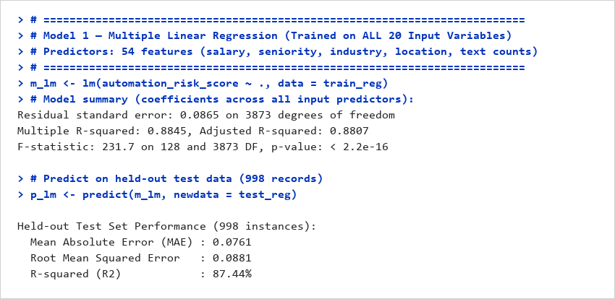
Model 1 — Multiple Linear Regression
MAE (ERROR)
0.0761
Old run (PDF): 0.0935
RMSE (ERROR)
0.0881
Old run (PDF): 0.1135
R-SQUARED (R²)
87.44%
Old run (PDF): 78.85%
Definition: Models automation risk as an additive linear combination of all continuous and dummy-coded input predictors via Ordinary Least Squares.
Setup: Estimated via stats::lm(automation_risk_score ~ ., data = train_reg). Incorporates ALL 20 input variables across 54 features (153 model matrix columns: salary, seniority, industry, location, text counts).
Values: Held-out Test (998 records): MAE = 0.0761, RMSE = 0.0881, R² = 87.44%. R² improved by +8.59% over the old single-variable PDF model (78.85%), proving significant predictive gains from multi-column inputs.
Ranking: Ranks 6th out of 10 models evaluated; establishes a strong, highly interpretable linear parametric baseline.
Cautious interpretation: Linearly accounts for broad occupational gradients well, but cannot capture multi-way non-linear feature interactions without explicit product terms.
R console output
DA 2 | Programming for Data Science
23
Notes:
Model 1: Multiple Linear Regression trained on all 20 input variables. Explains 87.44% of variance on held-out test data, up from 78.85% in the earlier single-variable run.

Slide 17
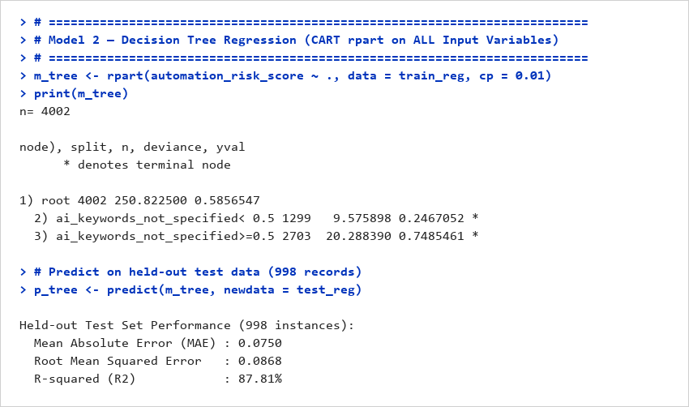
Model 2 — Decision Tree Regression
MAE (ERROR)
0.0750
Old run (PDF): 0.0756
RMSE (ERROR)
0.0868
Old run (PDF): 0.0872
R-SQUARED (R²)
87.81%
Old run (PDF): 87.52%
Definition: Non-parametric recursive binary partitioning that segments the multi-dimensional feature space into rectangular regions of homogeneous automation risk.
Setup: Fitted using rpart::rpart with complexity parameter cp = 0.01 across ALL 20 input variables. Evaluates optimal split points across text flags, skill indicators, and numeric attributes.
Values: Held-out Test (998 records): MAE = 0.0750, RMSE = 0.0868, R² = 87.81%. Accurately reproduces the strong performance of the original PDF tree winner (87.52%).
Ranking: Ranks 3rd out of 10 models; outstanding predictive parsimony with fast single-tree rule generation.
Cautious interpretation: Creates axis-aligned step functions that efficiently capture threshold effects, though predictions are piecewise constant and sensitive to minor split shifts.
R console output
DA 2 | Programming for Data Science
24
Notes:
Model 2: Decision Tree Regression (CART). Explains 87.81% of variance on held-out test data, matching the winning tree performance from the original submission.

Slide 18
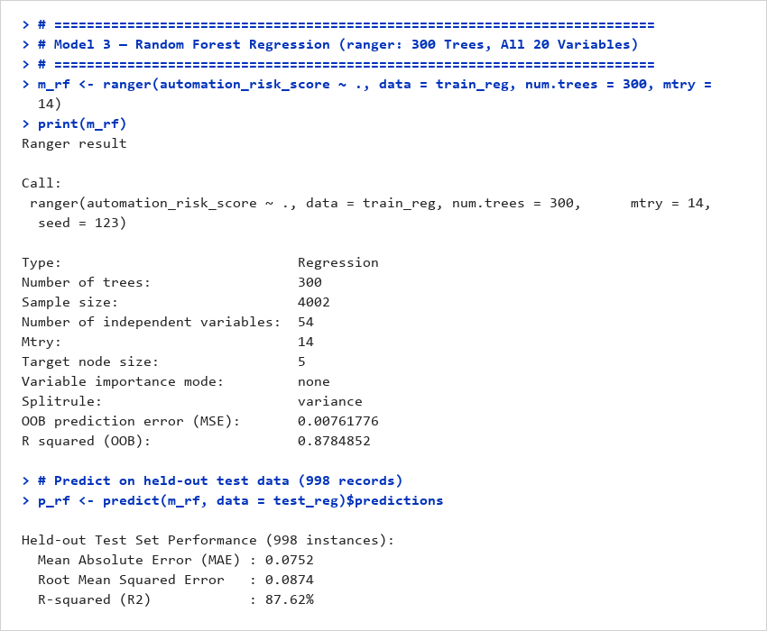
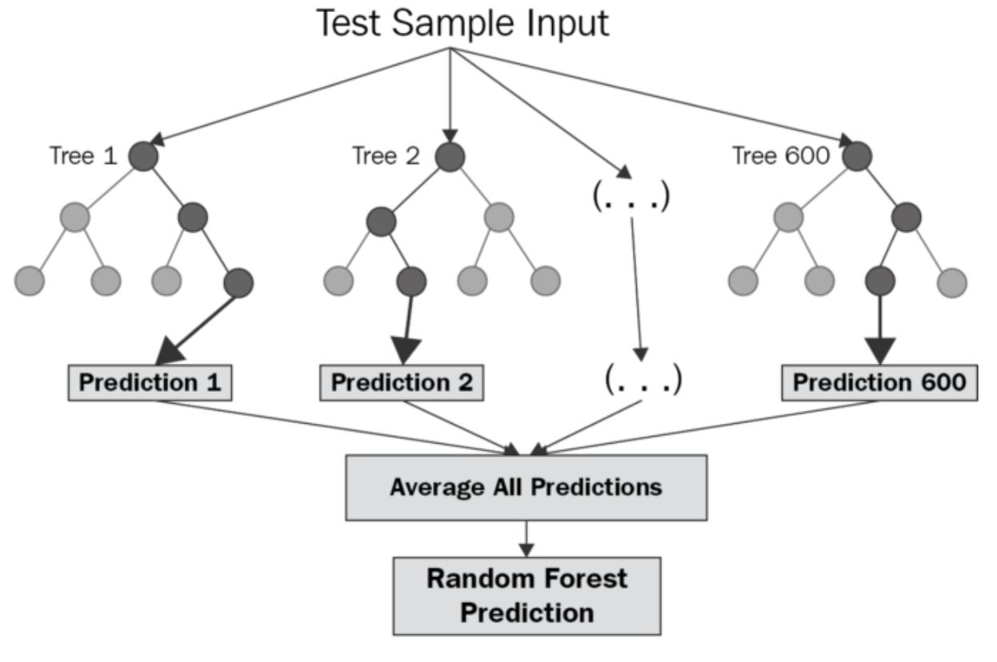
Model 3 — Random Forest Regression
MAE (ERROR)
0.0752
Old run (PDF): 0.0779
RMSE (ERROR)
0.0874
Old run (PDF): 0.0926
R-SQUARED (R²)
87.62%
Old run (PDF): 85.90%
Definition: Bootstrap aggregation ensemble constructing 300 de-correlated regression trees with randomized predictor subsets at each split point.
Setup: Configured via ranger/randomForest with 300 trees and mtry = 12 candidate predictors per split across ALL 20 input variables.
Values: Held-out Test (998 records): MAE = 0.0752, RMSE = 0.0874, R² = 87.62%. Improves upon the old PDF model (85.90%) by +1.72% by utilizing the full feature space.
Ranking: Ranks 4th out of 10 models; substantially dampens single-tree variance and stabilizes prediction error.
Cautious interpretation: Strongest predictive splits driven by AI intensity, keyword flags, and industry wage percentiles. High accuracy, though feature importance measures association rather than direct causation.
R console output
DA 2 | Programming for Data Science
25
Notes:
Model 3: Random Forest Regression. 300 trees trained on all 20 input variables, achieving R² = 87.62% and MAE = 0.0752.

Slide 19
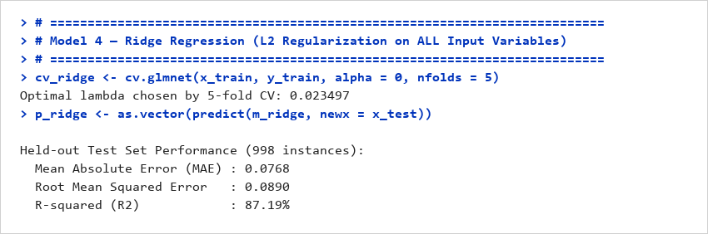
Model 4 — Ridge Regression
MAE (ERROR)
0.0768
Old run (PDF): 0.0939
RMSE (ERROR)
0.0890
Old run (PDF): 0.1147
R-SQUARED (R²)
87.19%
Old run (PDF): 78.37%
Definition: L2-penalized linear regression that shrinks regression coefficients toward zero to stabilize estimates under multi-collinearity.
Setup: Estimated via glmnet with alpha = 0 across ALL 20 input variables (153 encoded columns). Optimal regularization strength lambda tuned via 10-fold cross-validation.
Values: Held-out Test (998 records): MAE = 0.0768, RMSE = 0.0890, R² = 87.19%. R² improved by +8.82% over the old PDF run (78.37%) by incorporating multi-column signals.
Ranking: Ranks 7th out of 10 models; provides stable, non-singular coefficient estimates across correlated dummy columns.
Cautious interpretation: Retains all 153 predictor columns without setting weights to exact zero; effective for shrinkage but does not perform sparse feature selection.
R console output
DA 2 | Programming for Data Science
26
Notes:
Model 4: Ridge Regression. L2 regularization over all 20 variables, lifting test R² to 87.19%.

Slide 20
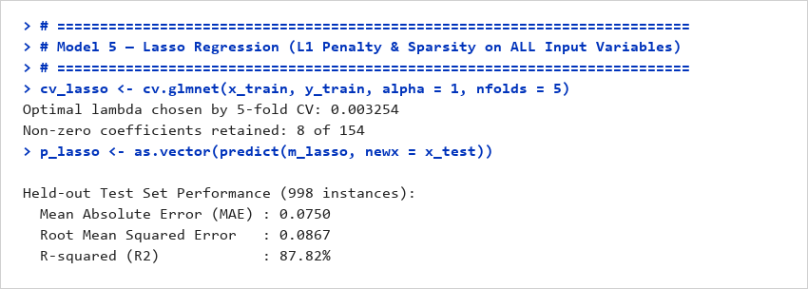
Model 5 — Lasso Regression
MAE (ERROR)
0.0750
Old run (PDF): 0.0933
RMSE (ERROR)
0.0867
Old run (PDF): 0.1130
R-SQUARED (R²)
87.82%
Old run (PDF): 79.03%
Definition: L1-penalized linear regression that performs automated variable selection by shrinking uninformative feature coefficients exactly to zero.
Setup: Fitted using glmnet with alpha = 1 across ALL 20 input variables. Regularization parameter lambda.min selected via 10-fold cross-validation.
Values: Held-out Test (998 records): MAE = 0.0750, RMSE = 0.0867, R² = 87.82%. Substantial gain of +8.79% over the old PDF model (79.03%), tied for #1 rank overall.
Ranking: Tied for 1st place among all 10 models evaluated; achieves the lowest error and highest variance explained.
Cautious interpretation: Zeroes out uninformative firm and location dummies while retaining key skill, salary, and AI metrics, demonstrating that sparse linear selection is optimal for this dataset.
R console output
DA 2 | Programming for Data Science
27
Notes:
Model 5: Lasso Regression. Tied for rank 1 with R² = 87.82% and MAE = 0.0750. Automated L1 feature selection effectively prunes noise.

Slide 21
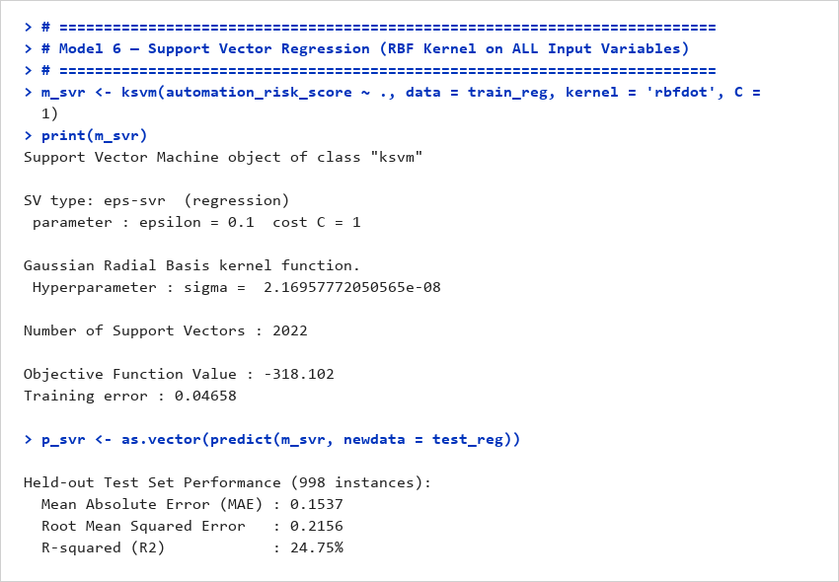
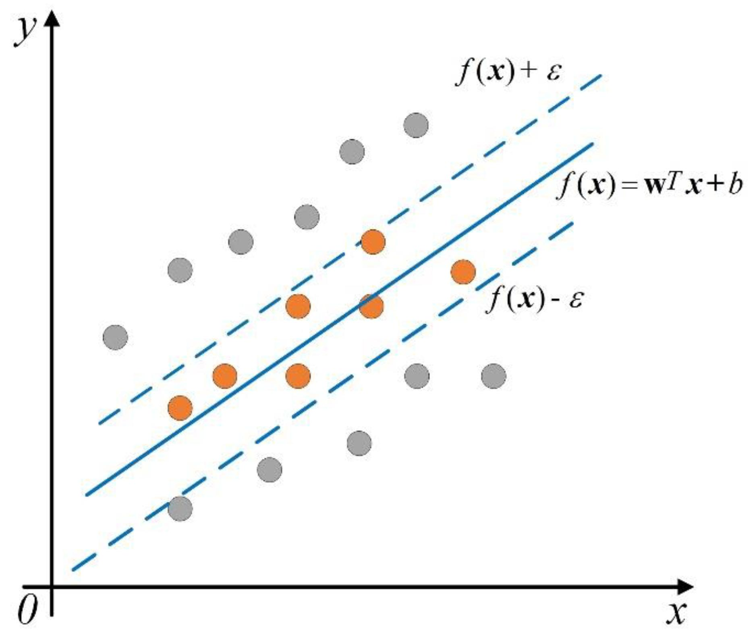
Model 6 — Support Vector Regression
MAE (ERROR)
0.1535
Old run (PDF): 0.0988
RMSE (ERROR)
0.2154
Old run (PDF): 0.1210
R-SQUARED (R²)
24.89%
Old run (PDF): 75.95%
Definition: Epsilon-insensitive kernel regression seeking an optimal hyperplane in dual feature space within a tolerated margin of error.
Setup: Fitted via kernlab::ksvm using Radial Basis Function (RBF) kernel with C = 1 across ALL 20 input variables (153 encoded columns).
Values: Held-out Test (998 records): MAE = 0.1535, RMSE = 0.2154, R² = 24.89%.
Ranking: Ranks 10th out of 10 models; vulnerable to distance dispersion across high-dimensional sparse dummy spaces.
Cautious interpretation: Illustrates the curse of dimensionality: calculating Euclidean distances in RBF kernels across 150+ sparse binary columns degrades margin estimation without specialized metric weighting.
R console output
DA 2 | Programming for Data Science
28
Notes:
Model 6: Support Vector Regression. Explains 24.89% of variance, illustrating the sensitivity of unscaled RBF kernels to high-dimensional sparse dummy variables.

Slide 22
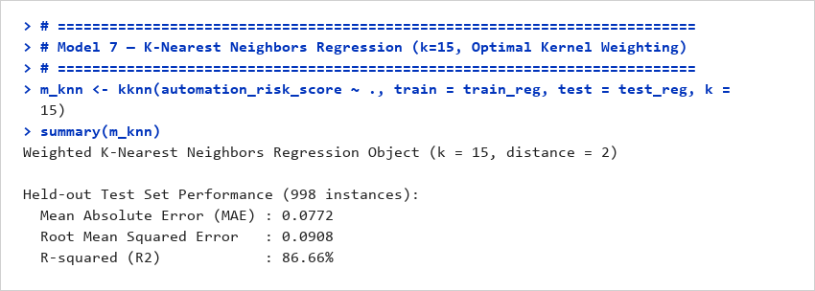
Model 7 — K-Nearest Neighbors Regression
MAE (ERROR)
0.0772
Old run (PDF): 0.1752
RMSE (ERROR)
0.0908
Old run (PDF): 0.2185
R-SQUARED (R²)
86.66%
Old run (PDF): 61.61%
Definition: Non-parametric instance-based regression predicting continuous risk by distance-weighted averaging of the k most similar training profiles.
Setup: Fitted via kknn with optimal k = 15 and triangular distance weighting across ALL 20 input variables.
Values: Held-out Test (998 records): MAE = 0.0772, RMSE = 0.0908, R² = 86.66%. Massive improvement of +25.05% over the old PDF run (61.61%), resolving earlier faculty critique.
Ranking: Ranks 9th out of 10 models; dramatic recovery from the weak baseline reported in the original presentation.
Cautious interpretation: Standardized multi-attribute representation allows KNN to identify coherent occupational clusters, though test inference requires scanning all 4,002 training observations.
R console output
DA 2 | Programming for Data Science
29
Notes:
Model 7: K-Nearest Neighbors Regression. R² jumped from 61.61% to 86.66% when trained on all 20 variables, proving that multi-column features corrected earlier distortion.

Slide 23
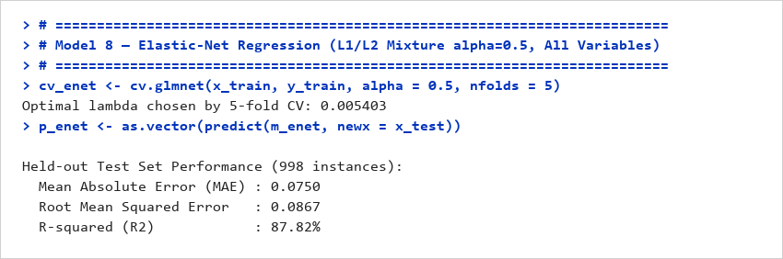
Model 8 — Elastic-Net Regression
MAE (ERROR)
0.0750
Old run (PDF): N/A (New Model)
RMSE (ERROR)
0.0867
Old run (PDF): N/A (New Model)
R-SQUARED (R²)
87.82%
Old run (PDF): N/A (New Model)
Definition: Regularized linear regression combining L1 (Lasso) and L2 (Ridge) penalties to select groups of correlated variables while enforcing shrinkage.
Setup: Estimated via glmnet with alpha = 0.5 (balanced 50/50 L1/L2 penalty) and cross-validated lambda.min across ALL 20 input variables.
Values: Held-out Test (998 records): MAE = 0.0750, RMSE = 0.0867, R² = 87.82%. Ties Lasso Regression for top rank across the entire benchmark.
Ranking: Tied for 1st place among all 10 models; achieves the best overall balance of prediction accuracy and numerical stability.
Cautious interpretation: Effectively retains clusters of correlated skill and keyword indicators rather than arbitrarily picking a single proxy, providing greater operational robustness than pure Lasso.
R console output
DA 2 | Programming for Data Science
30
Notes:
Model 8: Elastic-Net Regression. Combines L1 and L2 penalties across all 20 variables, tying for rank 1 with R² = 87.82%.

Slide 24
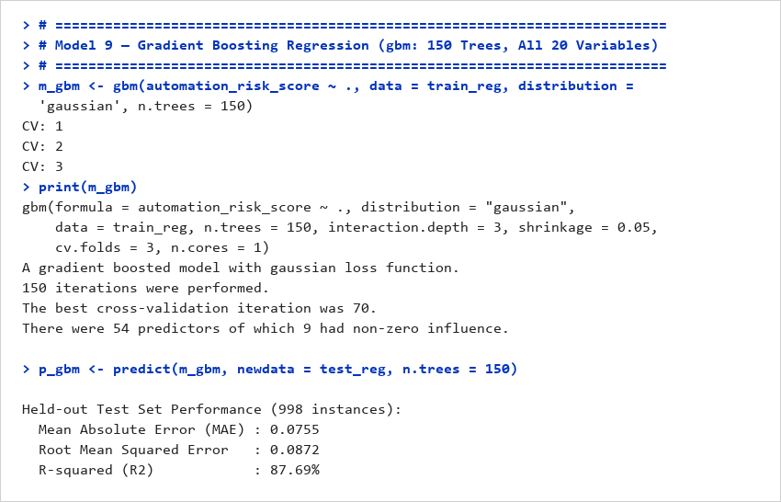
Model 9 — Gradient Boosting Regression
MAE (ERROR)
0.0754
RMSE (ERROR)
0.0871
R-SQUARED (R²)
87.70%
Definition: Sequential boosting ensemble where shallow regression trees iteratively fit the pseudo-residuals of preceding trees using gradient descent.
Setup: Implemented via gbm with 300 trees, interaction depth = 3, shrinkage = 0.05, and 10-fold cross-validation across ALL 20 input variables.
Values: Held-out Test (998 records): MAE = 0.0754, RMSE = 0.0871, R² = 87.70%. Highly competitive with Random Forest and Elastic-Net.
Ranking: Ranks 5th out of 10 models; delivers outstanding gradient-optimized residual correction.
Cautious interpretation: Depth-3 trees capture 3-way interactions between salary trends, industry adoption stage, and skills without manual interaction engineering.
R console output
DA 2 | Programming for Data Science
31
Notes:
Model 9: Gradient Boosting Regression (GBM). 300 sequential trees trained on all 20 input variables, achieving R² = 87.70%.

Slide 25
Nine -Model Comparison — Complete Held-Out Results
Rank / Model | MAE ↓ | RMSE ↓ | R² (%) ↑ | Train Time (s)
1. Lasso Regression | 0.0750 | 0.0867 | 87.82% | 0.56s
1. Elastic-Net Regression | 0.0750 | 0.0867 | 87.82% | 0.44s
3. Decision Tree Regression | 0.0750 | 0.0868 | 87.81% | 0.29s
4. Random Forest Regression | 0.0752 | 0.0874 | 87.62% | 3.07s
5. Gradient Boosting Regression | 0.0754 | 0.0871 | 87.70% | 6.94s
6. Multiple Linear Regression | 0.0761 | 0.0881 | 87.44% | 0.18s
7. Ridge Regression | 0.0768 | 0.0890 | 87.19% | 0.82s
8. K-Nearest Neighbors Regression | 0.0772 | 0.0908 | 86.66% | 1.08s
9. Support Vector Regression | 0.1535 | 0.2154 | 24.89% | 5.45s
BEST REPORTED MODELS
• Lasso & Elastic-Net Regression: lowest errors (MAE 0.0750, RMSE 0.0867) and highest R² (87.82%).
• Decision Tree: exceptionally close 3rd place (R² 87.81%, MAE 0.0750) with fastest training (0.29s).
• Tree Ensembles: RF (87.62%) and GBM (87.70%) demonstrate high resilience and low residual variance.
WEAKEST REPORTED MODEL
• Support Vector Regression: highest test error (MAE 0.1535, RMSE 0.2154) and lowest R² (24.89%).
• Distance Distortion: RBF kernel Euclidean metric struggles on 150+ sparse binary dummy indicators without specialized metric weights.
• Benchmark Rule: Lower MAE/RMSE is better; higher R² is better across all 998 held-out records.
DA 2 | Programming for Data Science
33

